Slide 1
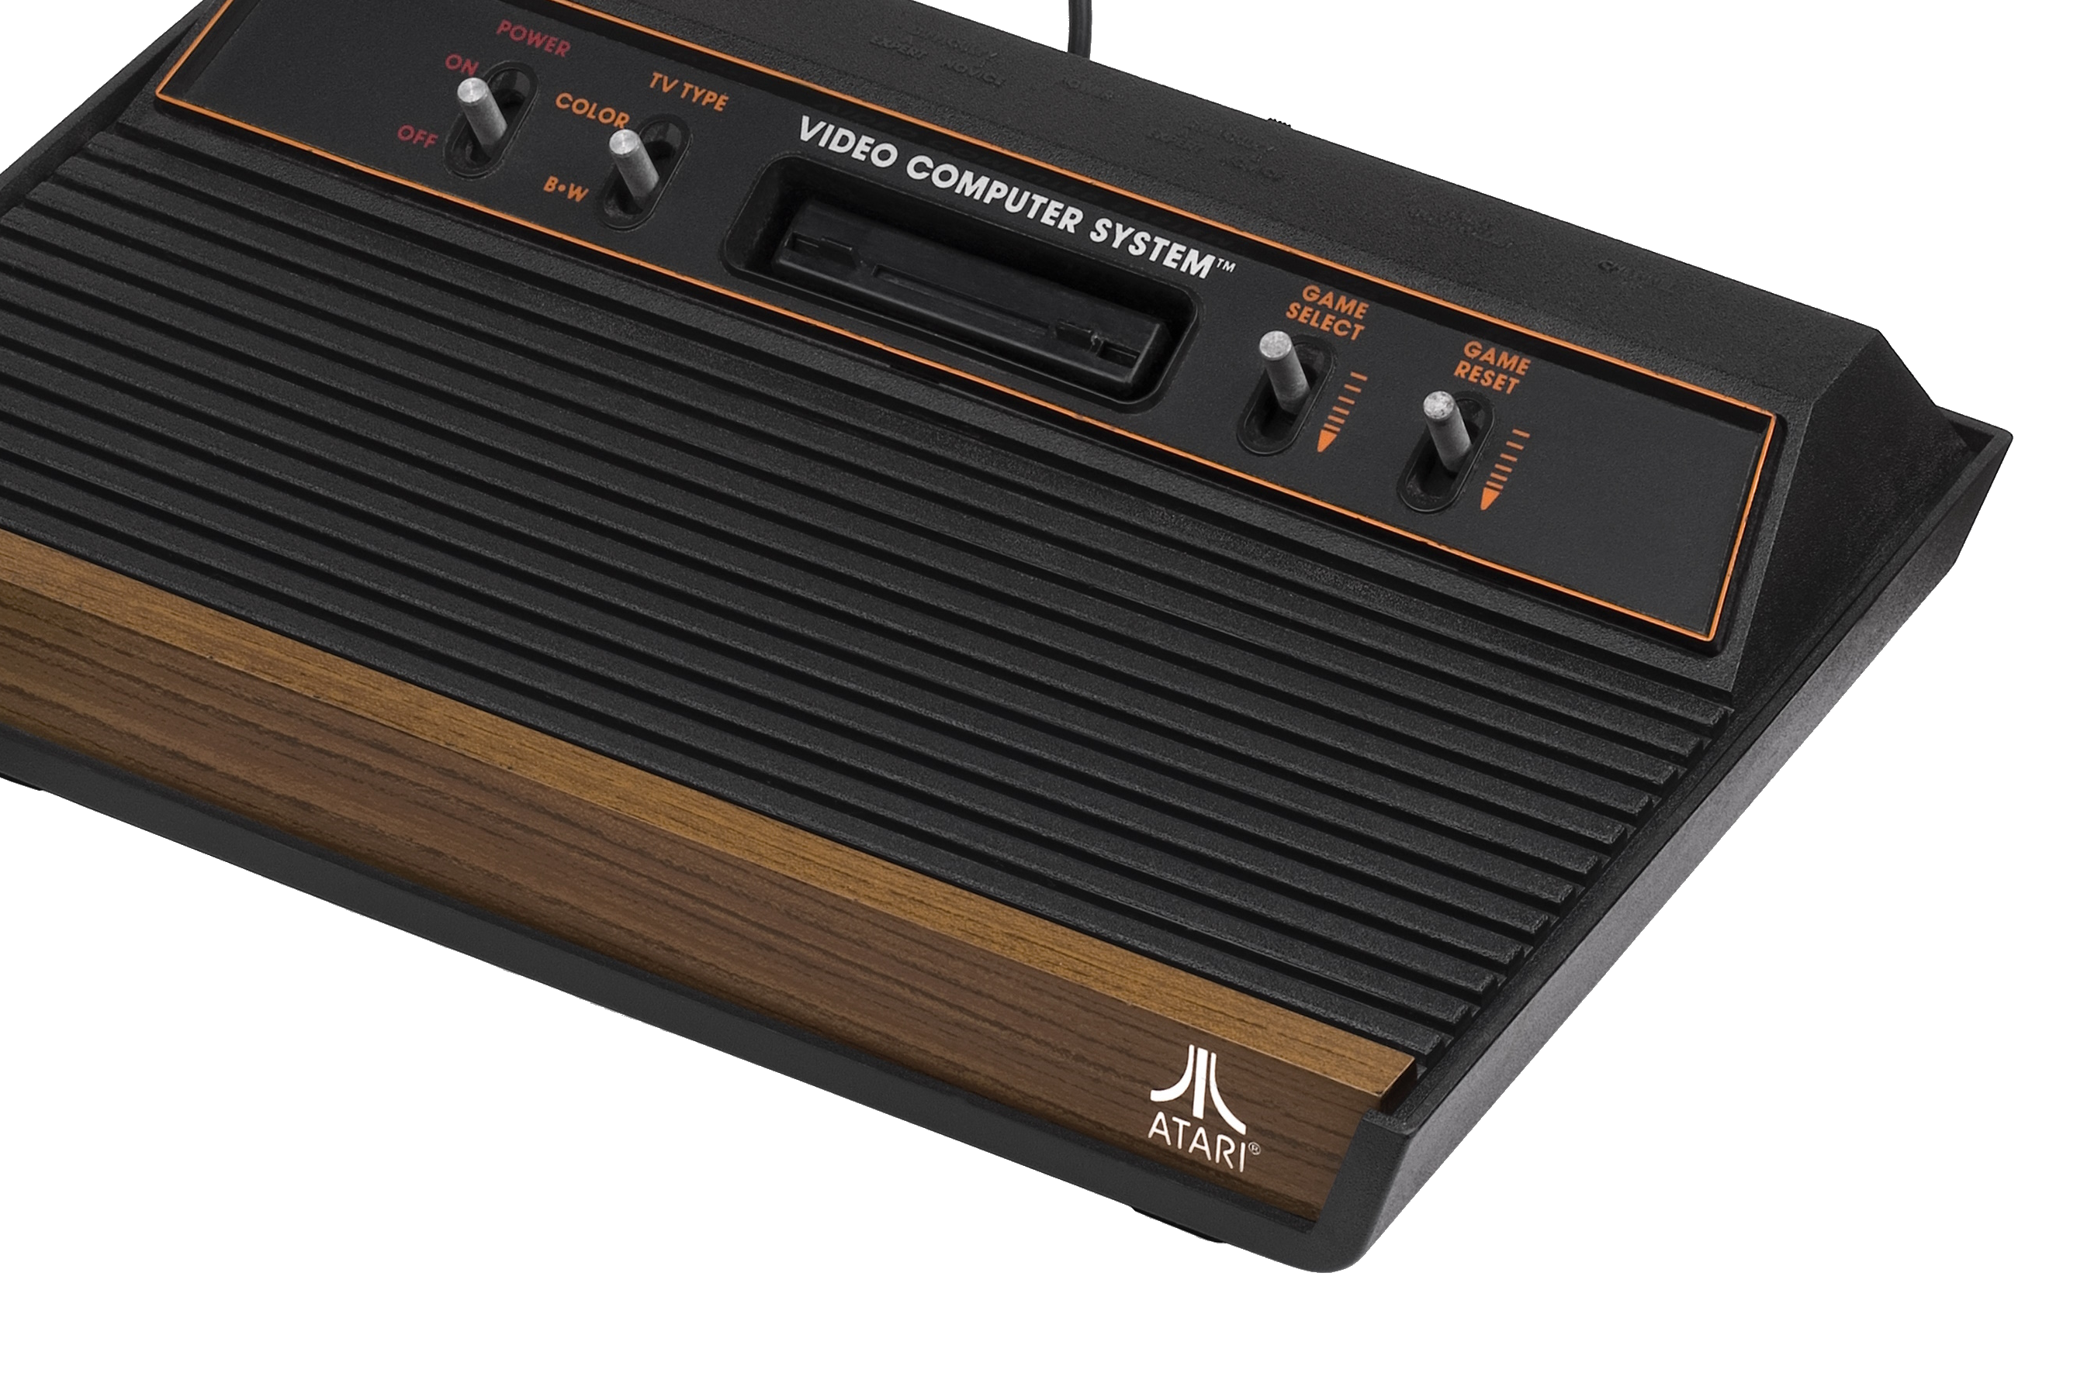
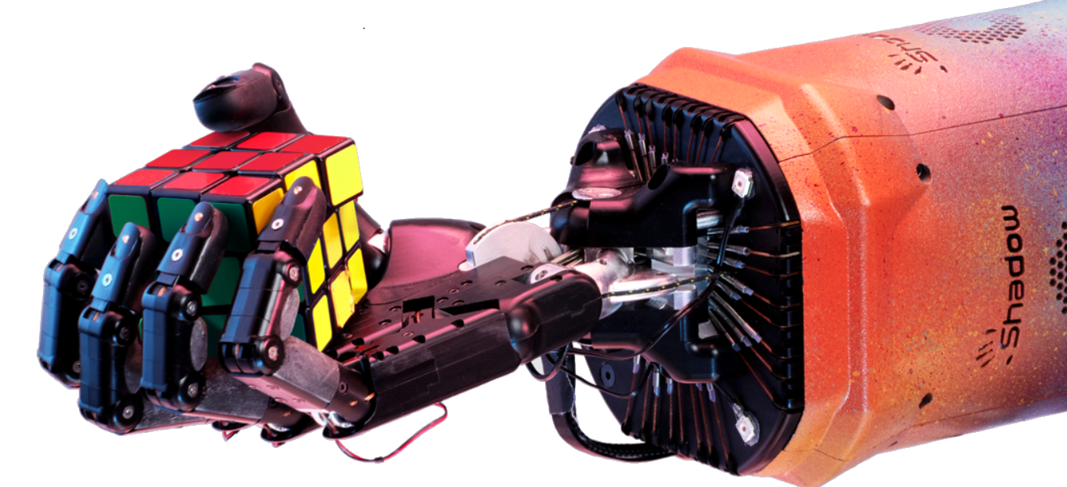

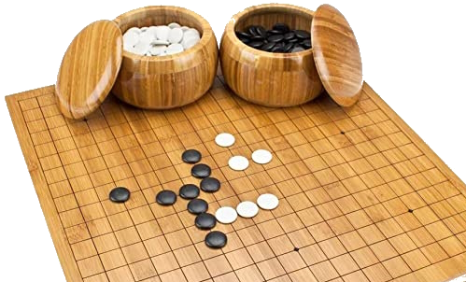




Reinforcement Learning unleashed
by Giovanni Gatti Pinheiro

Slide 2



Reinforcement learning is like teaching a computer how to make the best choices through trial and error, like coaching a pet to do tricks by rewarding good behaviour.
— ChatGPT

Slide 3
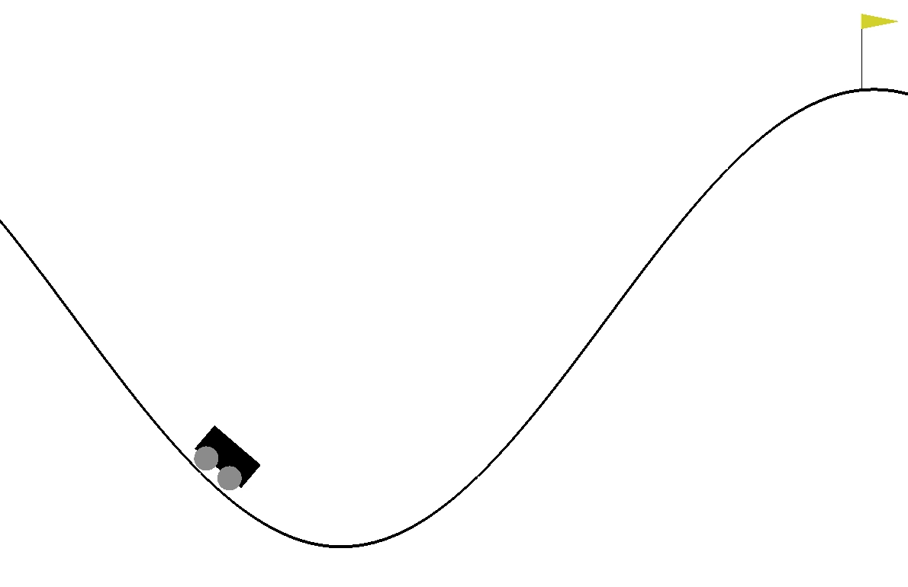
RL is about optimizing a sequence of decisions without the help of heuristics.
— Me

Slide 4
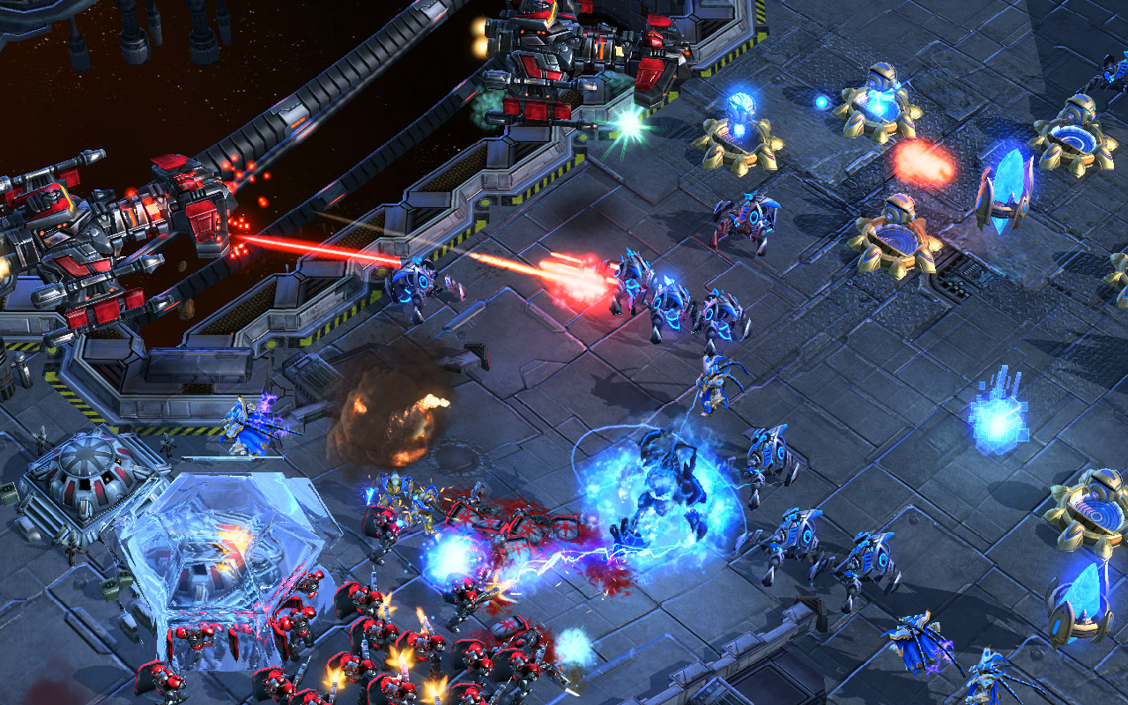
“trained by a reinforcement learning algorithm
that is designed to maximize the win-rate”

Slide 5
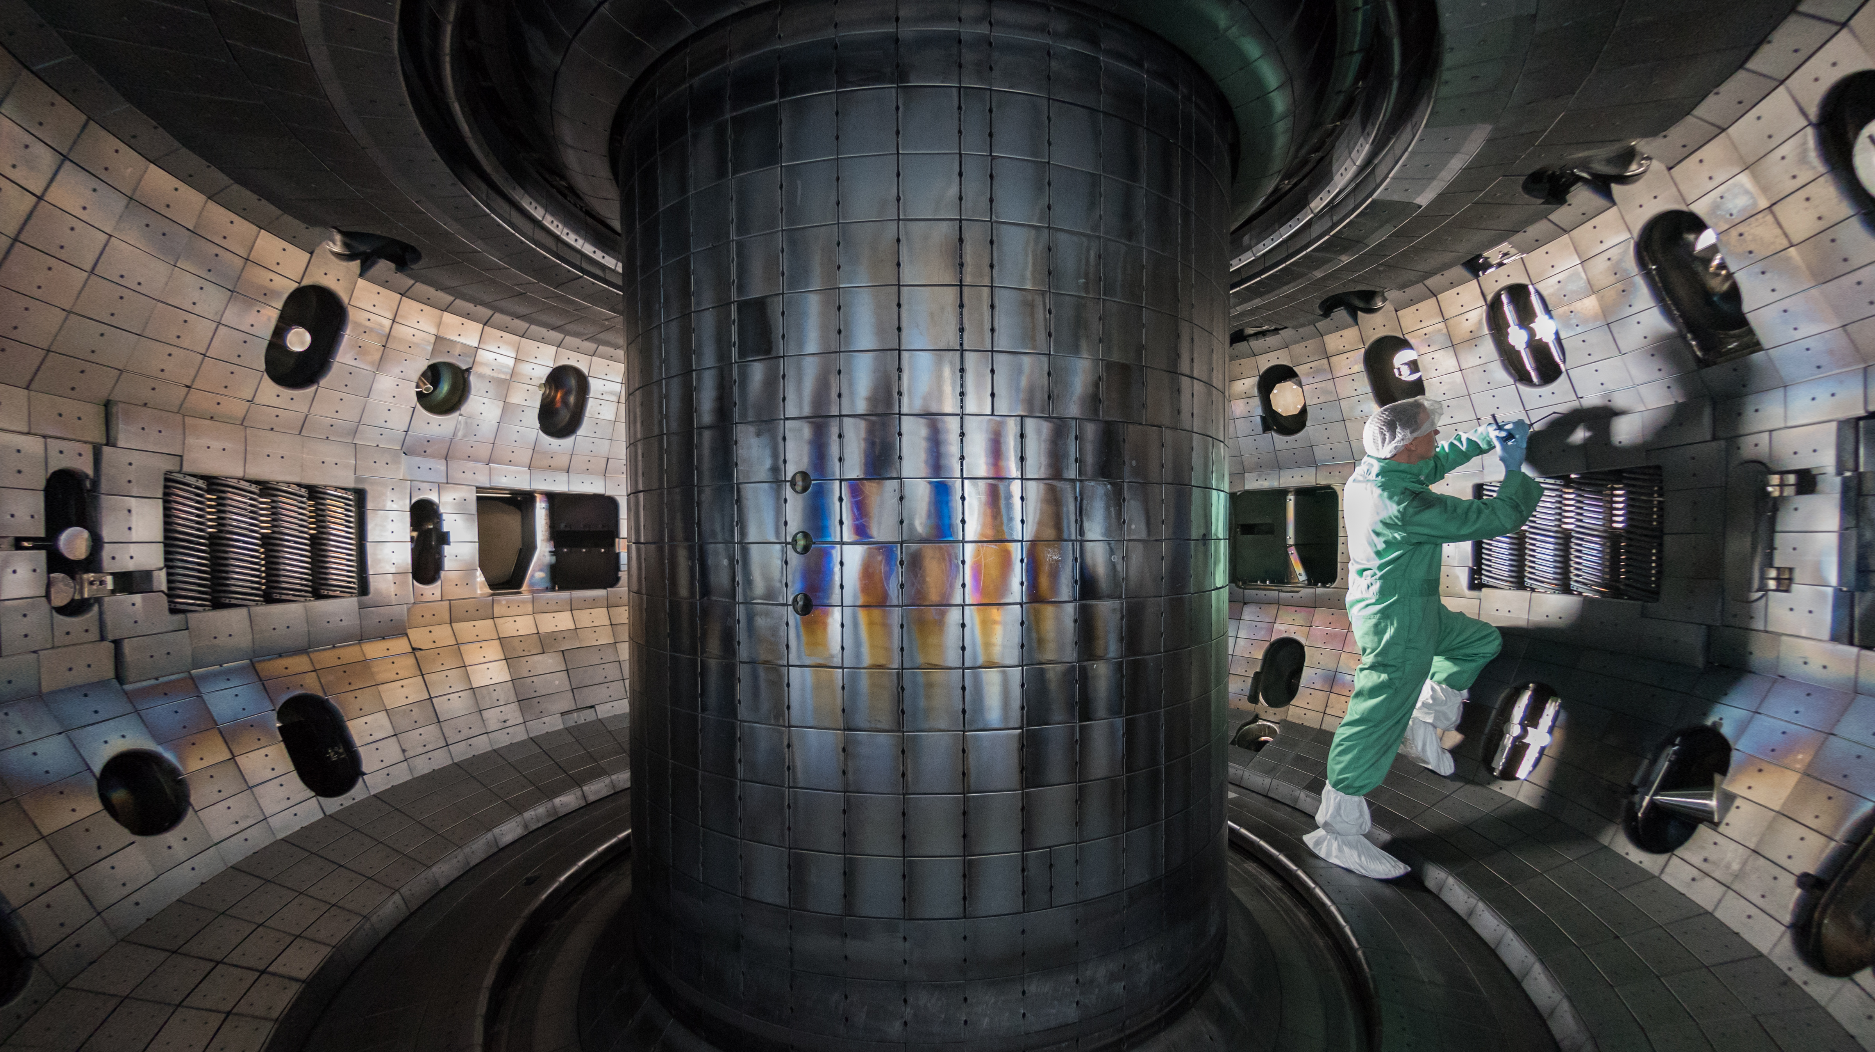
“Our control design fulfils many of the hopes of the community […], including high performance, robustness to uncertain operating conditions, intuitive target specification and unprecedented versatility”

Slide 6
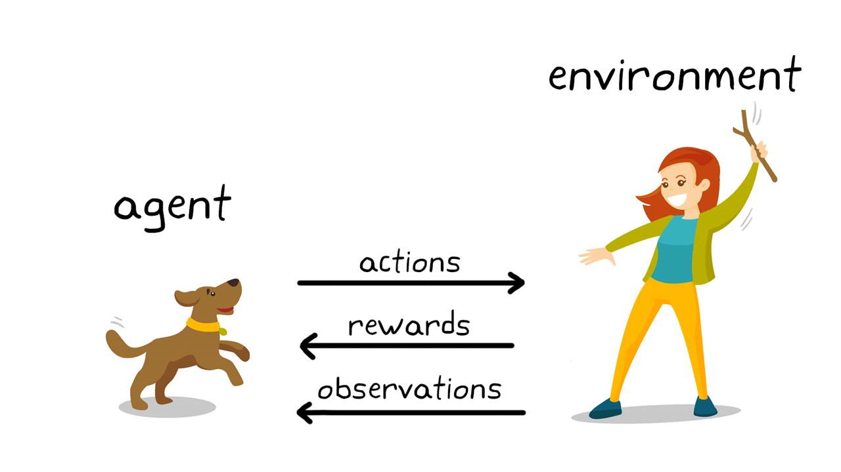

Slide 7
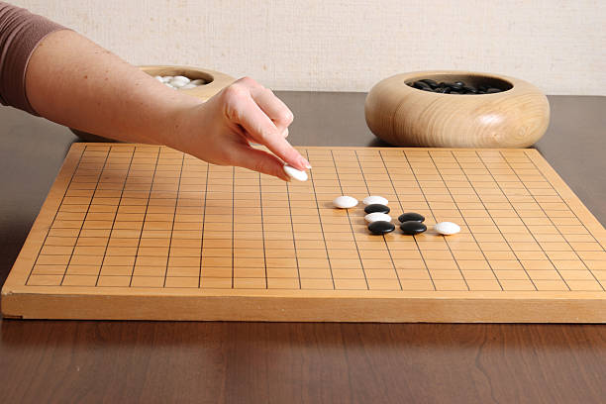
+1 victory, -1 defeat

Slide 8
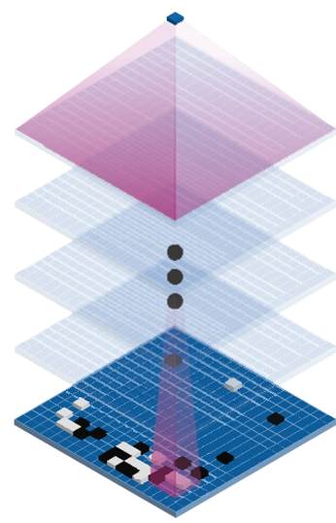
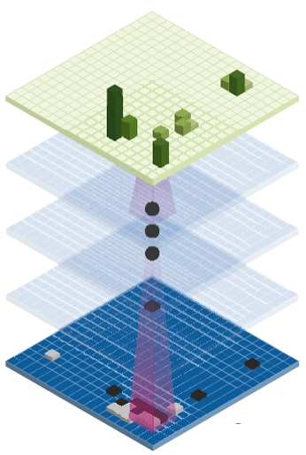
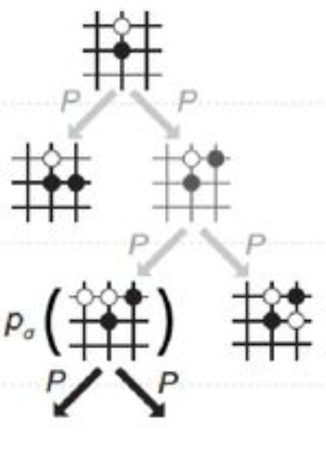
Value function
Policy function
Model (optional)

Slide 9
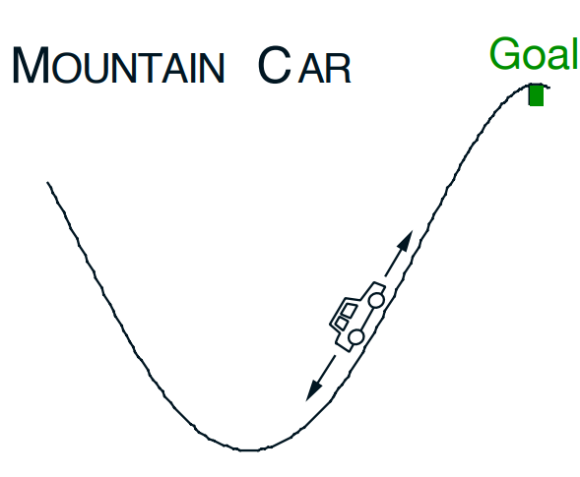
Hands-on
Observation:
X position
Velocity
Actions:
Accelerate to left
Don’t accelerate
Accelerate to right
Rewards:
-1 for each timestep

Slide 10
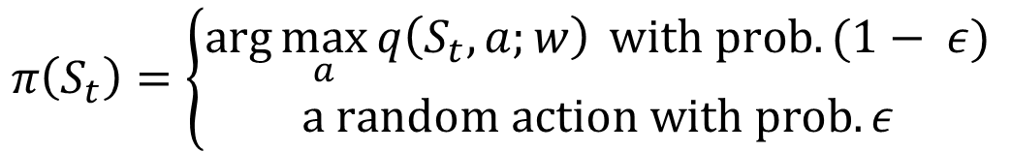
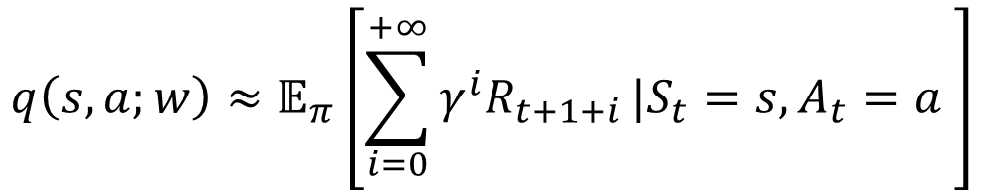
Hands-on
Action value function
$$q\left(s,a;w\right)≈𝔼_{π}\left[\sum_{i=0}^{+∞}{{γ^{i}R}_{t+1+i}}|S_{t}=s, A_{t}=a \right]$$
Policy function
$$π\left(S_{t}\right)=\left\{\begin{aligned}\arg{\max_{a}{q\left(S_{t},a;w\right)} with prob. (1− ε)} \\ a random action with prob. ε\end{aligned}\right.$$
Update (Semi-gradient SARSA)
$$w←w+α\left[R_{t+1}+γq\left(S_{t+1},A_{t+1};w\right)−q\left(S_{t},A_{t};w\right)\right]∇_{w}q\left(S_{t},A_{t};w\right)$$
Target
Current estimation

Slide 11
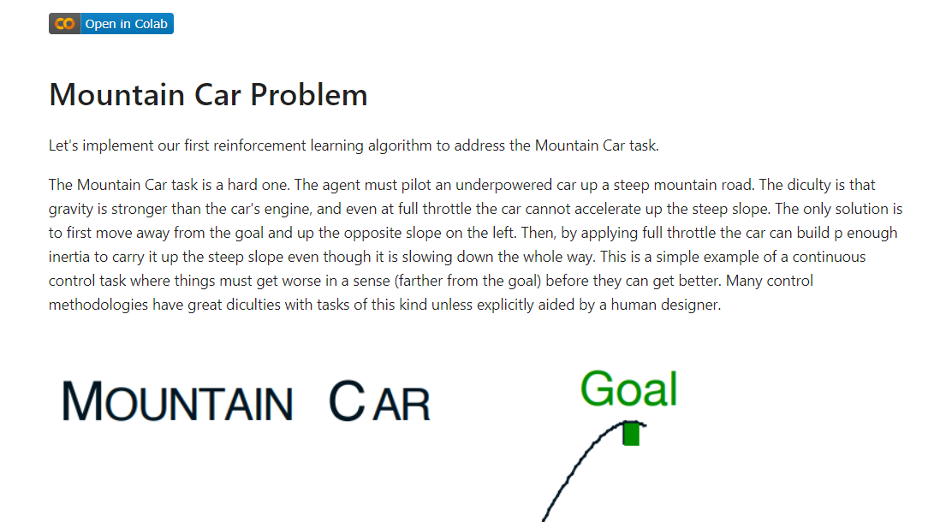
Hands-on

Slide 12
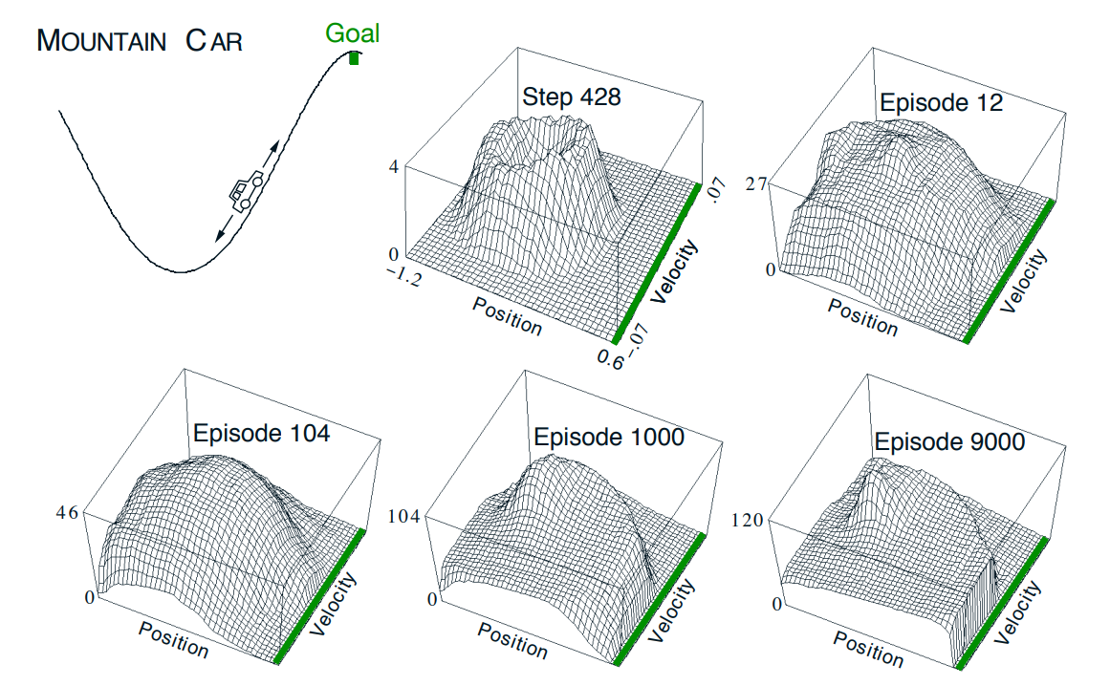
Hands-on

Slide 13
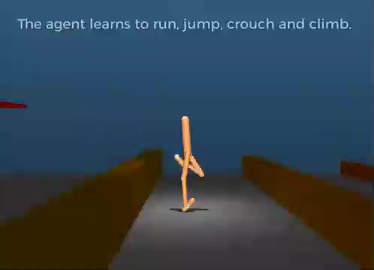
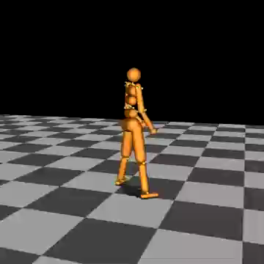
Why deep RL does not work (yet)!
Training costs
RL
No-RL
6400 CPU hours
Computed in near real-time (and 2012 hardware)

Slide 14
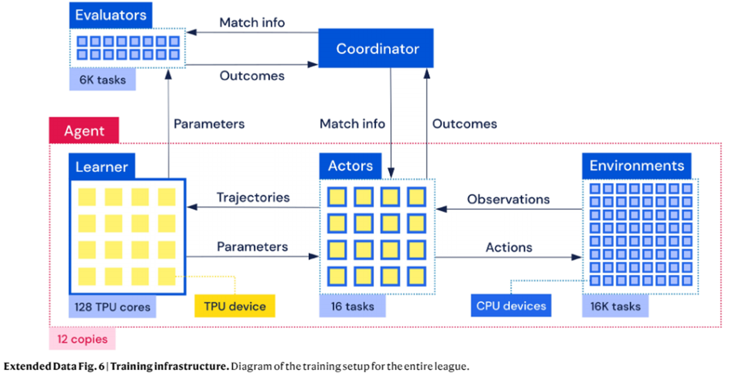

Slide 15
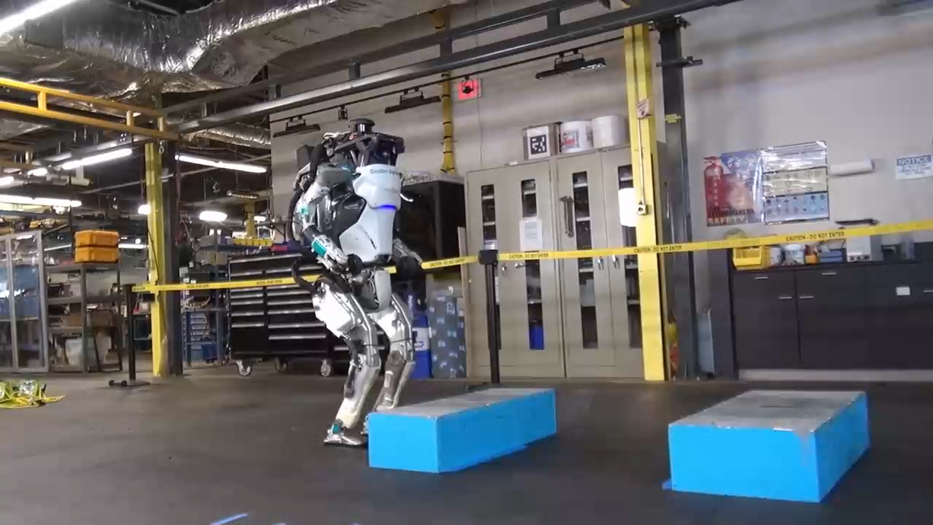
Why deep RL does not work (yet)!
Heuristics often work
time-varying LQR, QP solvers, convex optimization

Slide 16
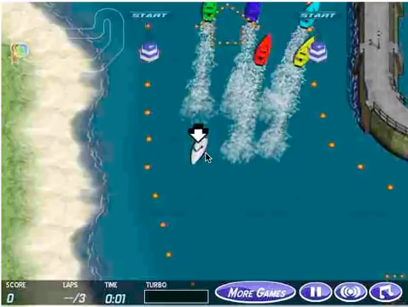
Why deep RL does not work (yet)!
Designing the reward signal

Slide 17
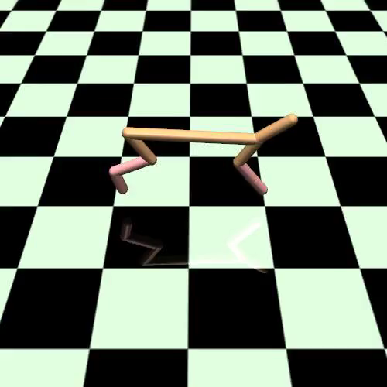

Why deep RL does not work (yet)!
Failed convergence

Slide 18
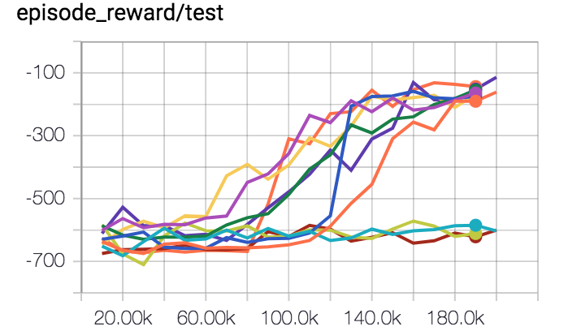
Why deep RL does not work (yet)!
Reproducibility
(on HalfCheeta)
30% failure rate
\

Slide 19
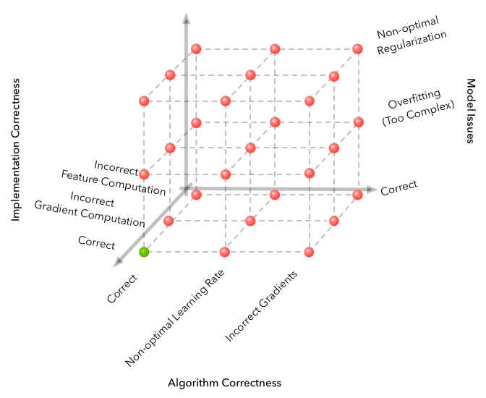
Why machine learning is hard?
RL adds a new dimension: luck!

Slide 20
Summary
RL is powerful because it can tackle problems where human ingenuity fails (heuristics)
But it needs data. A lot of it.
That comes with computer power. A lot of it.
It is not plug and play…

Slide 21
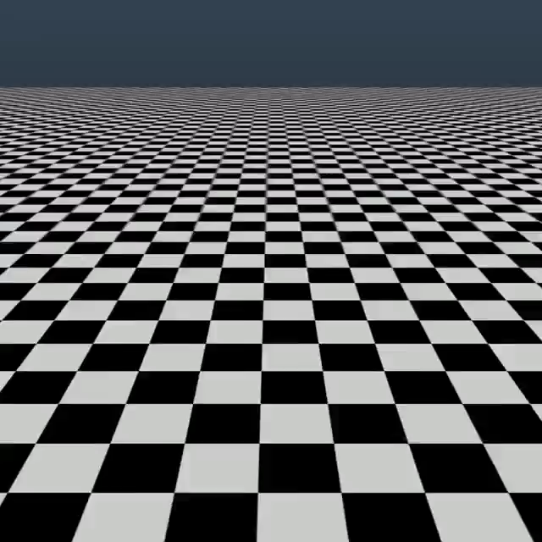
RLHF

